Slide 1

Software Engineering
WS-2017-2018
23.Oct
30.Oct
From 15.00-18.00 h Room 8-103
06.Nov
13.Nov
20.Nov
27.Nov
04.Dec
11.Dec
18.Dec
08.Jan
15.Jan
22.Jan
29.Jan
05.Jan
12.Jan
19.Jan
26.Jan
https://www.yammer.com/uni-2017-2018

Slide 2


Who am I?
Damir Dobric
Microsoft PTSP (Partner Technical Solution Specialist) Microsoft Most Valuable Professional
Blog
Twitter
damir.dobric@daenet.com b-dadobr@microsoft.com
https://about.me/damirdobric

Slide 3
Learning C#
https://www.microsoft.com/net/tutorials/csharp/getting-started

Slide 4
AGENDA
What is .NET Core?
Why .NET Core?
It runs on:
Win8, Win10 (all windows devices=> UWP + system32)
Linux, Mac-OS and ...
It does not support ARM
Does not run on Android
Does not run on iOS.

Slide 5
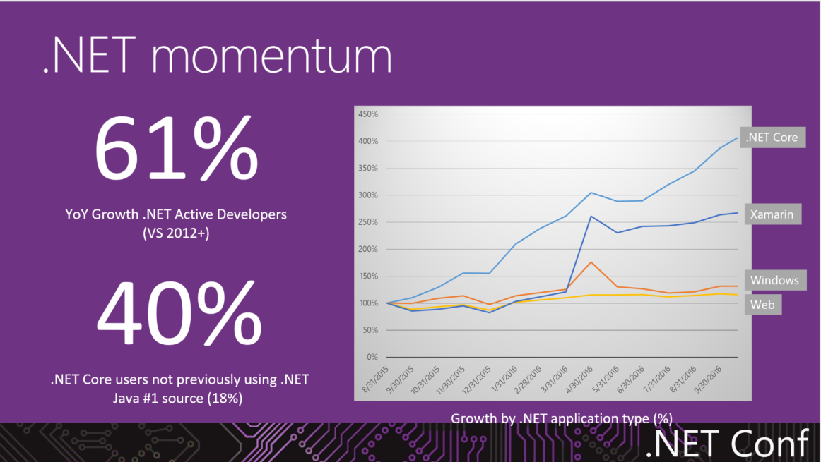

Slide 6
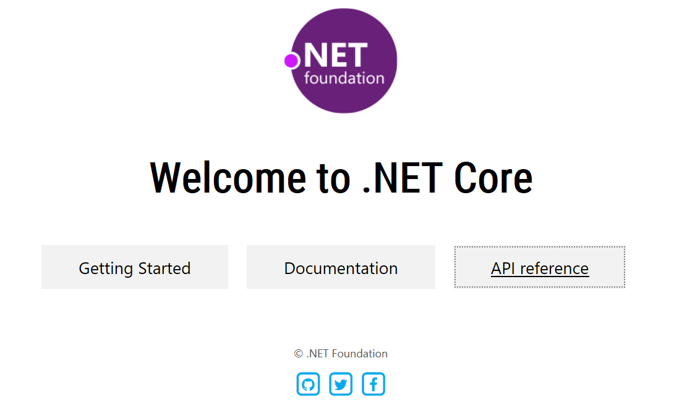
Where to start?
https://dotnet.github.io

Slide 7
any platform, any application, any developer

Slide 8
.NET Core is
a general purpose development platform
with cross-platform support for
Windows, macOS and Linux, various devices and cloud

Slide 9
What is .NET Core?
.NET Core is Open Source .NET framework.
Invented for Cloud Development but
It runs on:
Win8, Win10 (all windows devices=> UWP + system32)
Linux, Mac-OS and ...
ARM on-going
Linux ARM32
Windows IoT-Core ARM32

Slide 10
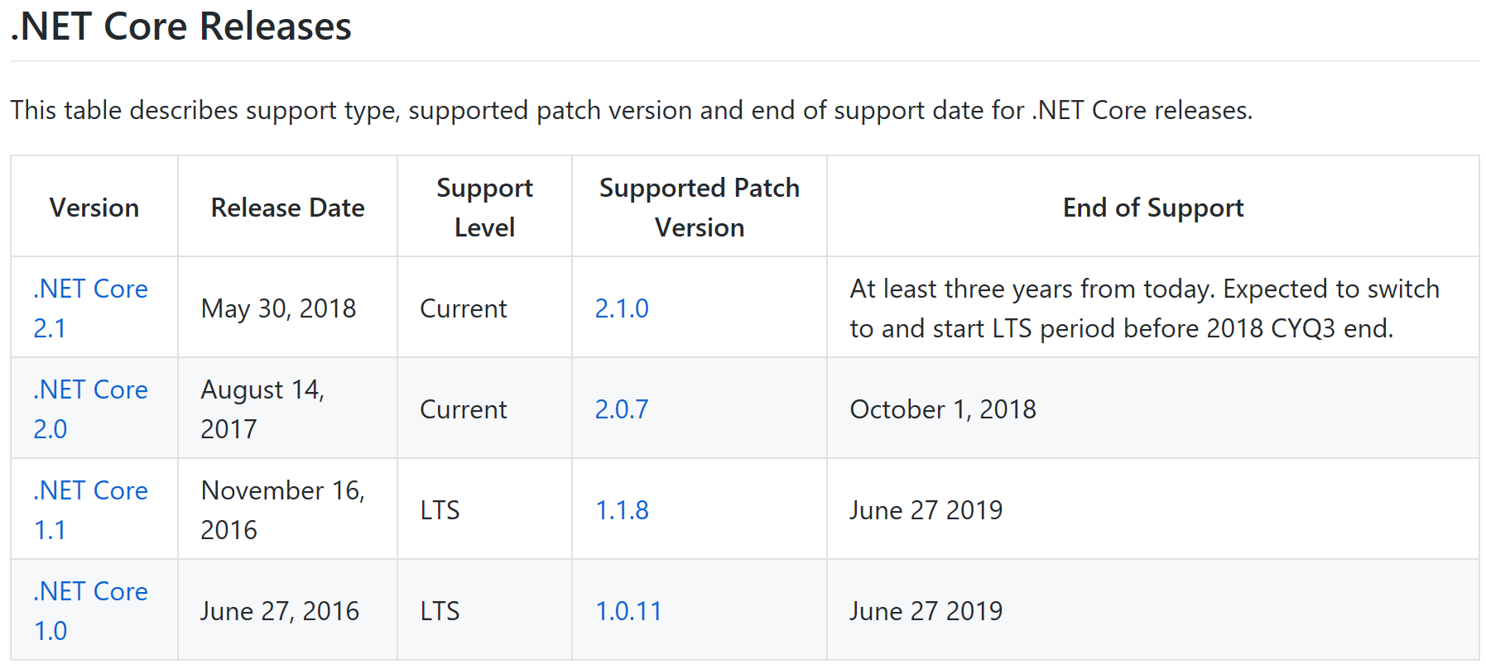
https://github.com/dotnet/core/blob/master/microsoft-support.md

Slide 11
Welcome .NET Core 2.1.x
Plattform support
Windows Client: 7, 8.1, 10 (1607+)
Windows Server: 2008 R2 SP1+
macOS: 10.12+
RHEL: 6+
Fedora: 26+
Ubuntu: 14.04+
Debian: 8+
SLES: 12+
openSUSE: 42.3+
Alpine: 3.7+
Chip support
x64 on:
Windows,
macOS,
Linux
x86 on
Windows
ARM32 on Linux (Ubuntu 18.04+, Debian 9+)
VS 15.7
https://github.com/dotnet/core/blob/master/release-notes/2.1/2.1-supported-os.md

Slide 12






Inside of .NET Core
runtime
libraries
tools
compilers
host

Slide 13

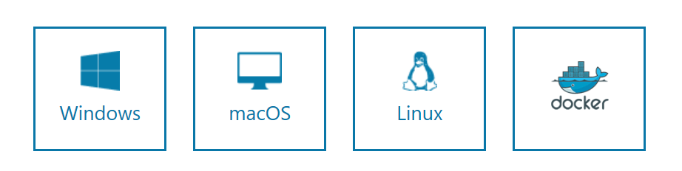
https://www.microsoft.com/net/download/core
> C:\Program Files\dotnet

Slide 14
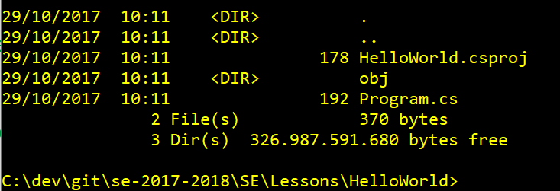
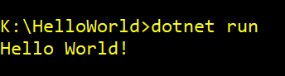
Create your first .NET Core application
//Create a new folder
mkdir YOURAPP
// Go to folder
cd YOURAPP
// Create a new .NET Core project
dotnet new console
// Create a new .NET Core project
dotnet restore
// Build the project
Dotnet build
// Run application
dotnet run

Slide 15
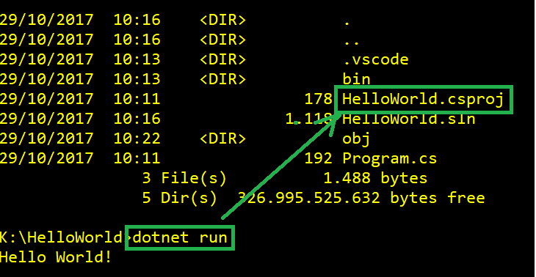
Running build
If you have a source code and command prompt is in folder which contains project file csproj, then you cas simply use dotnet run.

Slide 16
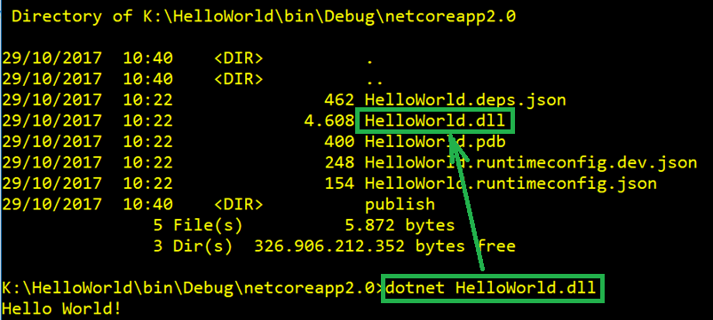
Running application without “csproj”
.NET Core application is a DLL (Dynamic Link Library)

Slide 17
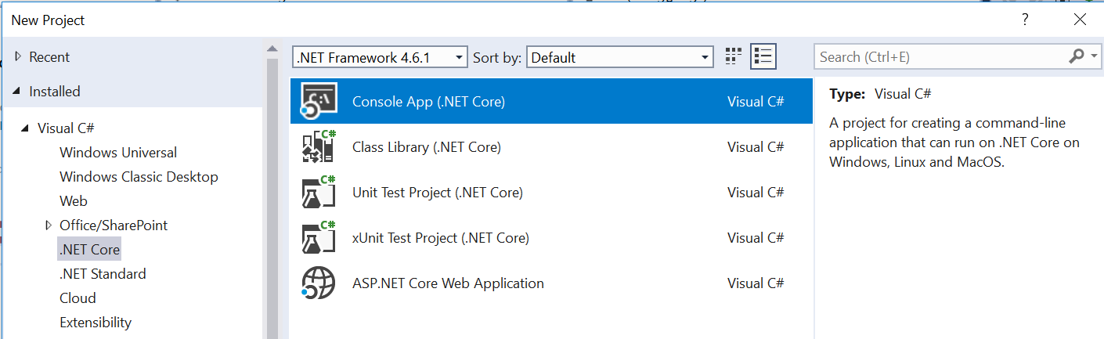
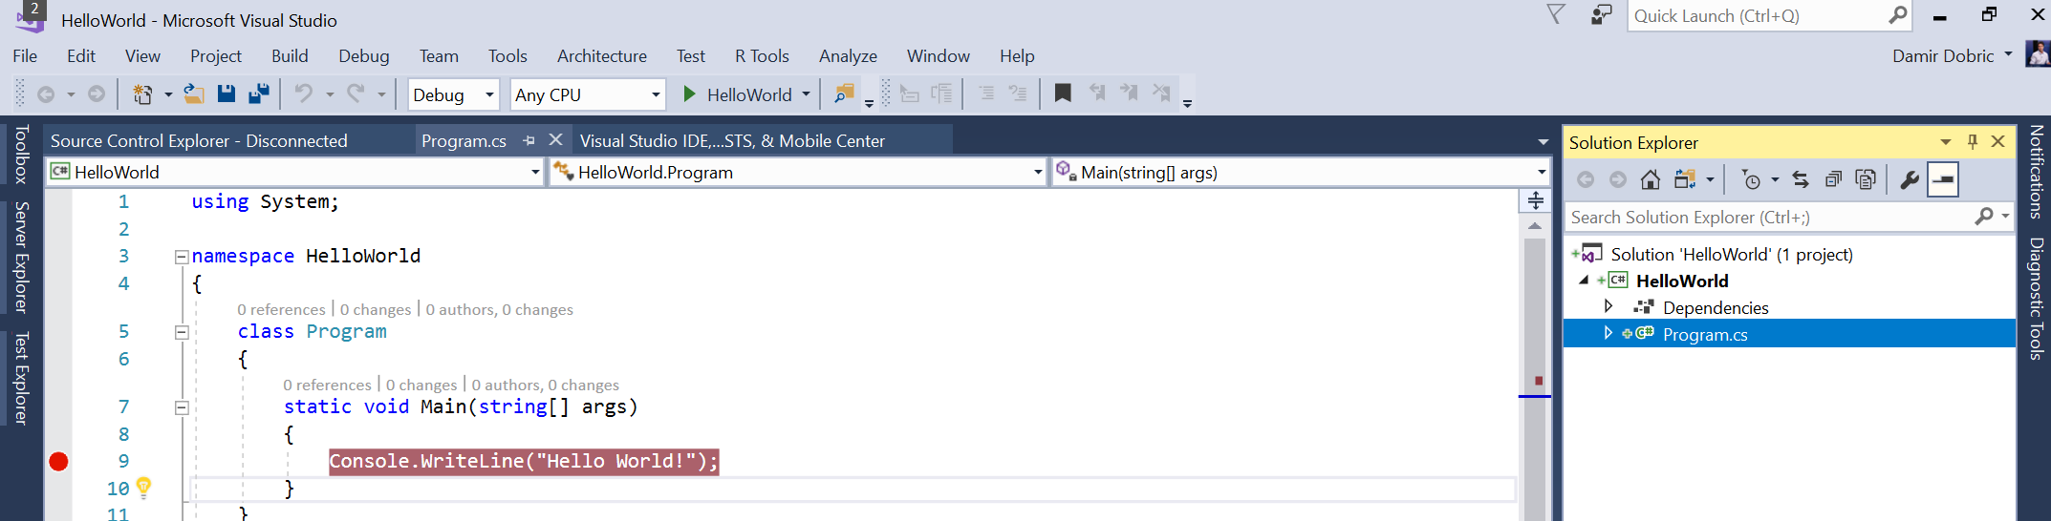
Create an application with Visual Studio

Slide 18
Exercises
E1 - Install .NET Core
E2 - Create your first program with command line
E3 - Create your first program with Visual Studio
E4 – Learn about Structure of Application.

Slide 19
(E1) Install VS & .NET Core SDK
The best way to develop with .NET Core on Windows is using Visual Studio. We will work in course with this version.
You can alternatively use download Visual Studio Code.
Download .NET CORE SDK https://www.microsoft.com/net/download/core

Slide 20
(E2)Create a project with command line
//Create a new folder
mkdir YOURAPP
// Go to folder
cd YOURAPP
// Create a new .NET Core project
dotnet new
// Create a new .NET Core project
dotnet restore
// Build the project
dotnet build
// Run application
dotnet run

Slide 21
(E3)Create Application in VS
In Solution Explorer, open the context menu for the Console Application (.NET Core) project. Name it "App", and set some the location. .
Open the Program.cs and paste following code:
Set a breakpoint after the line that you just added.
Press F5 to run the application..
The application should build without error, and should hit the breakpoint.
using System;
namespace ConsoleApplication
{
public class Program
{
public static void Main(string[] args)
{
Console.WriteLine("Hello World!");
}
}
}

Slide 22
(E4)Structure of App & Reading Files
The basics of the .NET Core Command Line Interface (CLI).
The structure of a C# Console Application.
Reading from File
Writing output to console
The basics of the Task Asynchronous Programming Model in .NET Core.
https://docs.microsoft.com/en-us/dotnet/articles/csharp/tutorials/console-teleprompter

